Slide 1
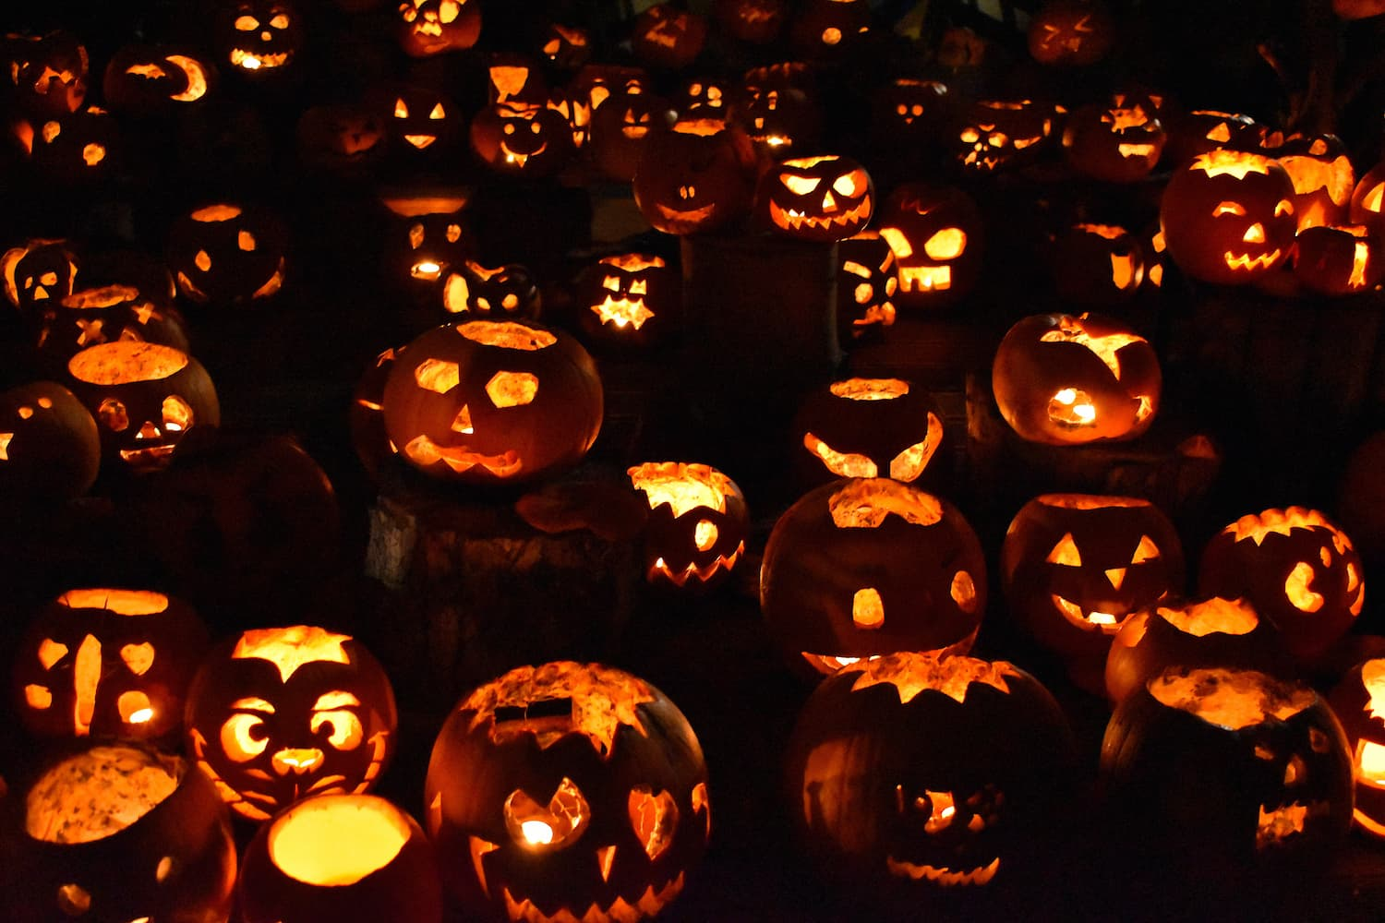
Starter: Would you enter the Otherworld?
Imagine you live in Scotland hundreds of years ago. The harvest is over, winter is beginning, and tonight is Samhain.
What might people fear at this time of year?
What might they believe happens after death?
What could people do if they believed spirits were nearby?

Slide 2
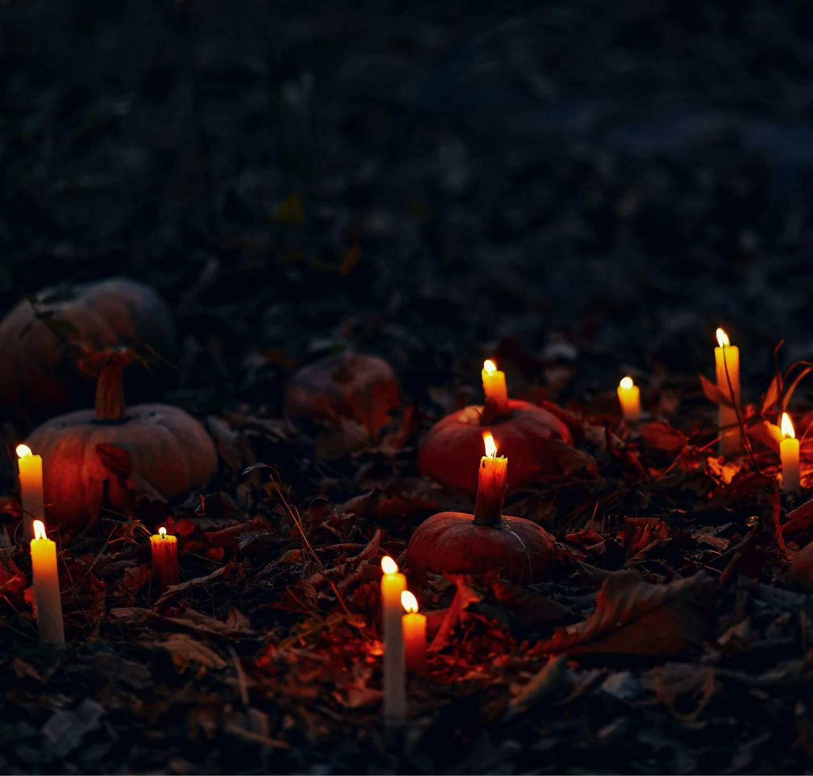
Should we believe everything we cannot explain?

Slide 3
Should we believe everything we cannot explain?
Learning Intention:
To explore Samhain traditions and investigate how beliefs about the supernatural influence people’s understanding of mysterious events.
Success Criteria:
I can describe at least one belief or tradition associated with Samhain.
I can work collaboratively to investigate a mystery.
I can evaluate evidence and explain how beliefs might influence interpretations.

Slide 4
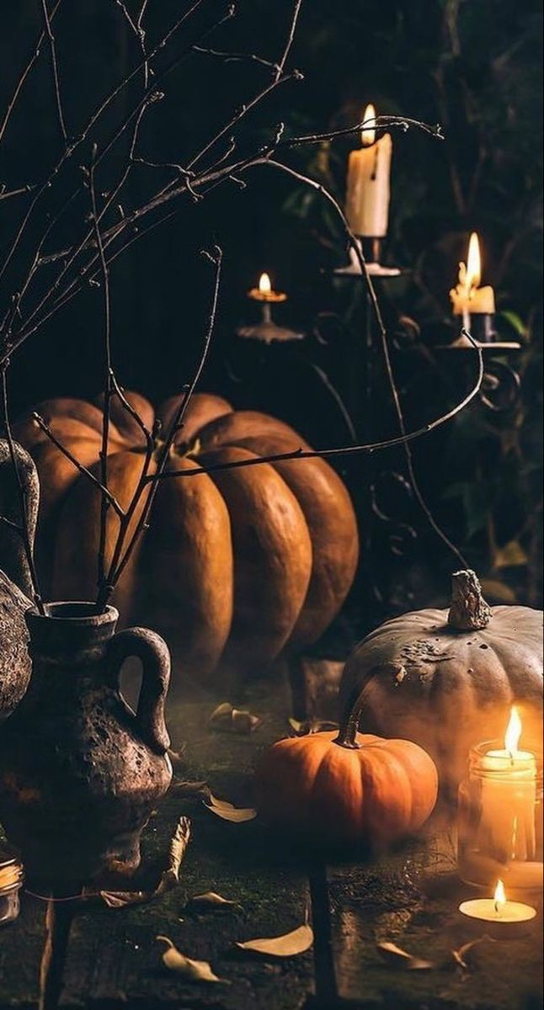
The Samhain Story
Samhain is a Celtic festival (pronounced Sa-wayne) which marked the end of the harvest and the beginning of winter
It was also when the boundary between our world and the Other was weaker, allowing ancestors and fairies to roam
Customs varied across communities and changed over time (especially with the introduction of Christianity)
Some Scottish Samhain traditions included bonfires, turnip lanterns, guising and divination.
Notes:
For more info: https://blog.historicenvironment.scot/2023/10/samhainn-and-the-scottish-traditions-of-halloween/

Slide 5
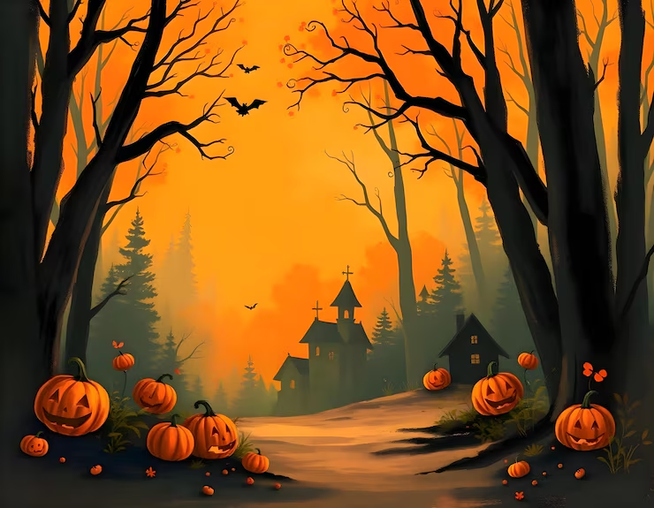
The Samhain Story
This lesson explores how people respond when they believe something supernatural may be happening

Slide 6
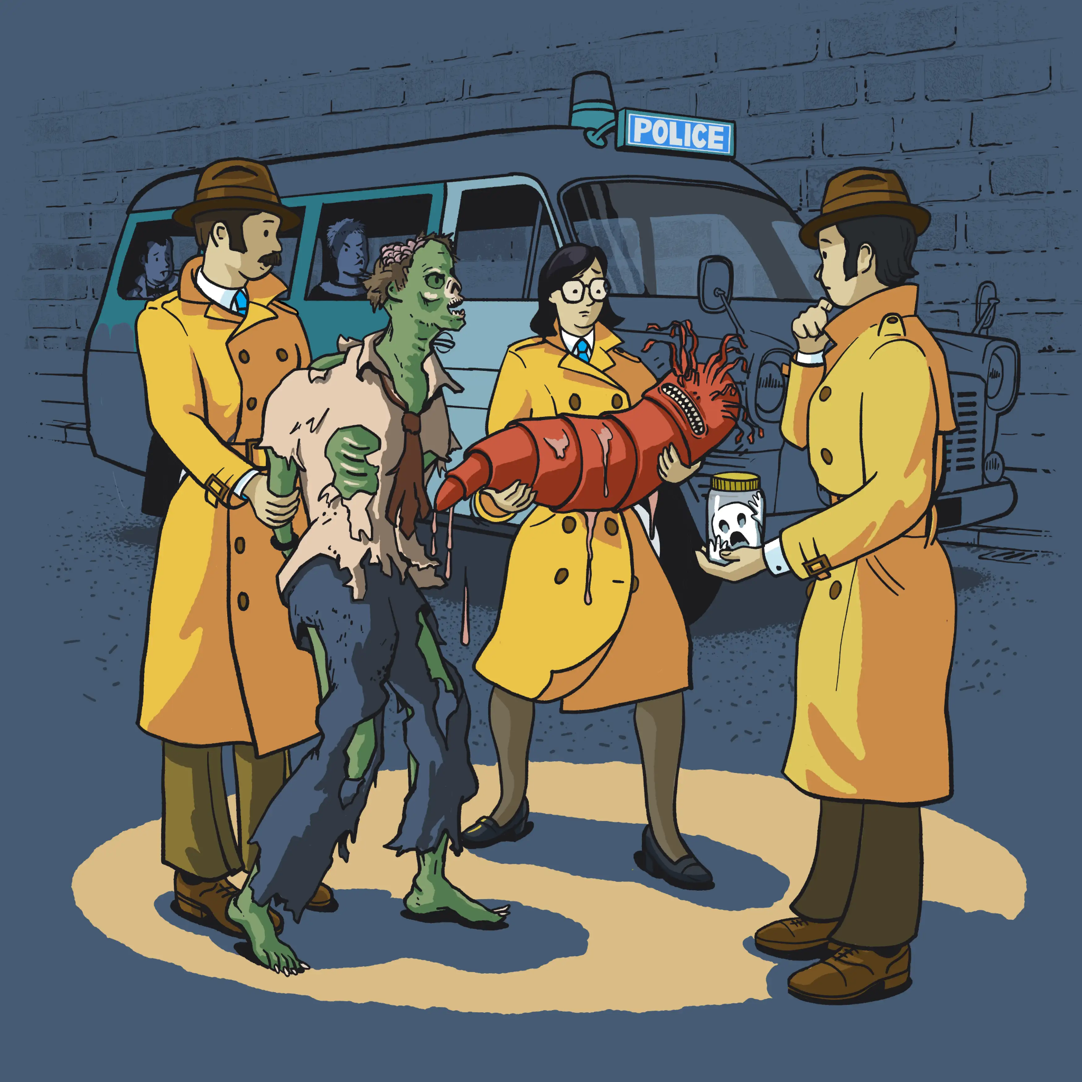
The Samhain Investigation
Strange events have been reported around the school, and the Headteacher wants an investigation before anyone spreads rumours!
In groups of 3-4 you will receive a case file
You will produce a Samhain Investigation Report
  You can use a written report, comic strip, news report, or an illustrated evidence board OR use the template

Slide 7
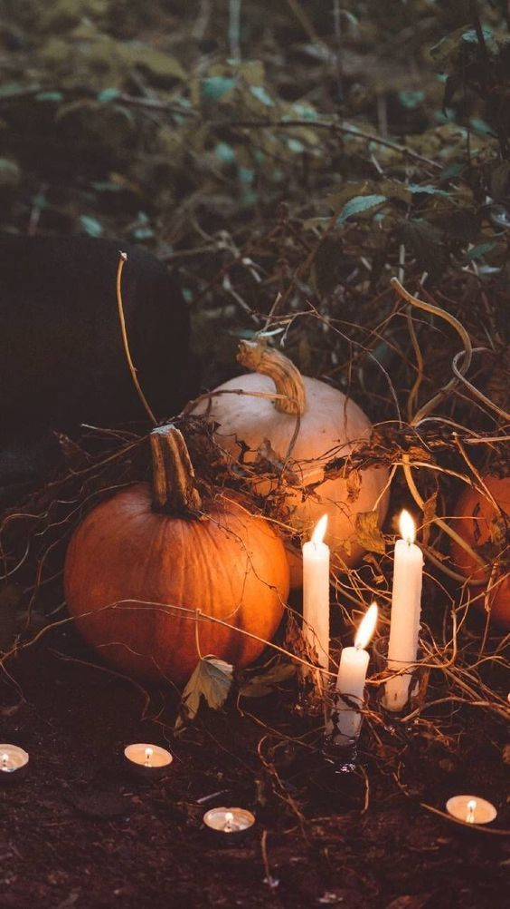
The Samhain Investigation
Your Samhain Investigation Report should include:
Your verdict on what happened
Two pieces of evidence
A natural explanation and a supernatural explanation
An explanation of how Samhain beliefs might influence people’s perception of the events
A final recommendation to the Headteacher
Notes:
Important: there is no official answer. Teams should consider the evidence and explain their reasoning rather than simply guess

Slide 8

Investigation Checklist:
Our verdict: What do we think happened? Give your best explanation
The evidence: Choose two clues that support your explanation
Another possibility: What is an alternative explanation? Could we be wrong?
The RMPS connection: Why do some people believe in ghosts, spirits or life after death? How might religious or cultural beliefs influence their interpretation?
Final recommendation: Should the school investigate further, dismiss the reports, or leave the mystery unsolved? Justify your decision
Notes:
Important: there is no official answer. Teams should consider the evidence and explain their reasoning rather than simply guess

Slide 9
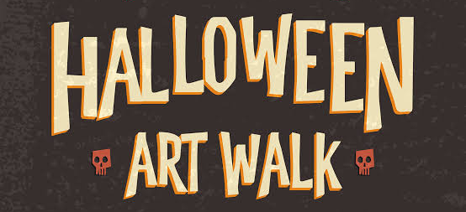
Gallery Walk: Who solved the mystery?
As you walk around the room and view other teams’ investigations and identify:
  The most convincing explanation
  The strongest use of evidence
  A team that considered a different perspective
Think, pair, share: would people who believed in the Otherworld interpret this mystery differently from someone who did not? Why?

Slide 10
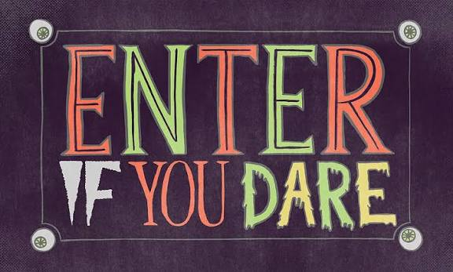
Challenge: New Samhain Tradition
Design a modern Samhain tradition for our school that respects the festival’s cultural and spiritual significance
Explain how it connects to the changing seasons, beliefs about the Otherworld, or remembering ancestors

Slide 11
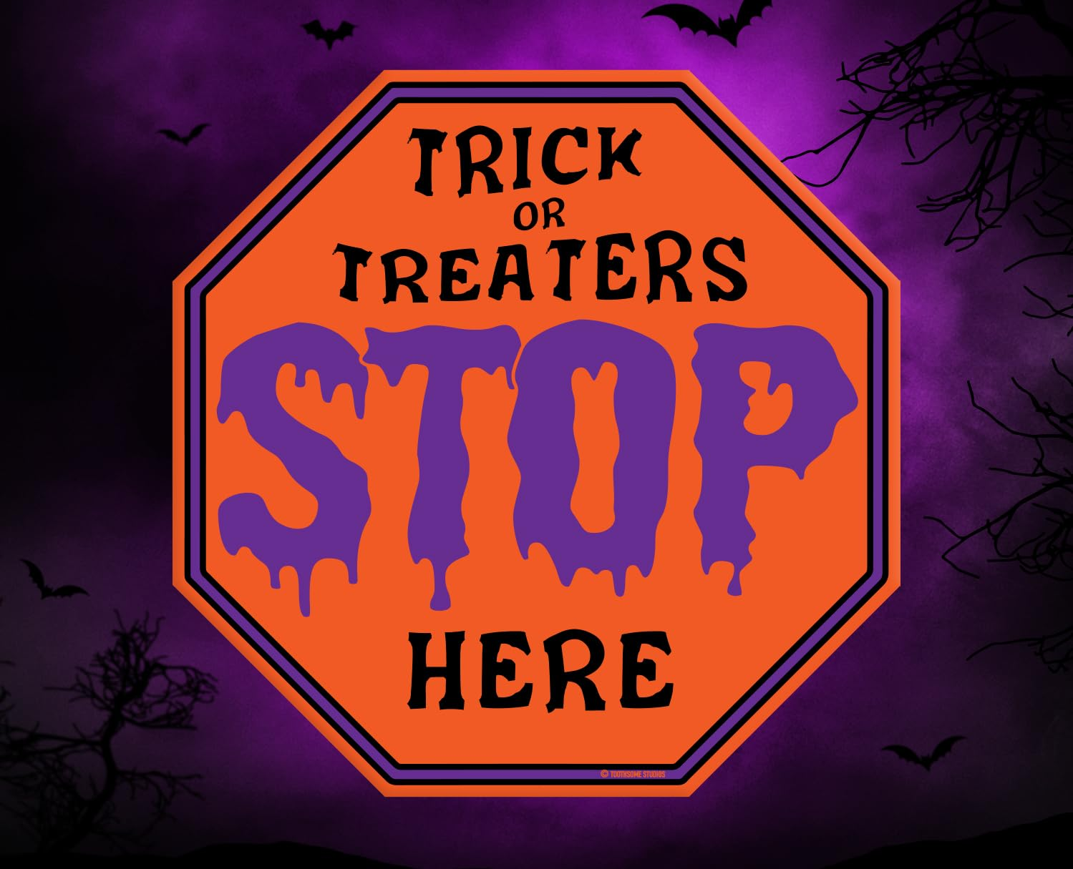
Plenary: What do we believe?
Complete the sentence:
  “Samhain helps us understand that beliefs about the supernatural can influence people because…”
Return to the big question: Should we believe everything we cannot explain?

