Slide 1
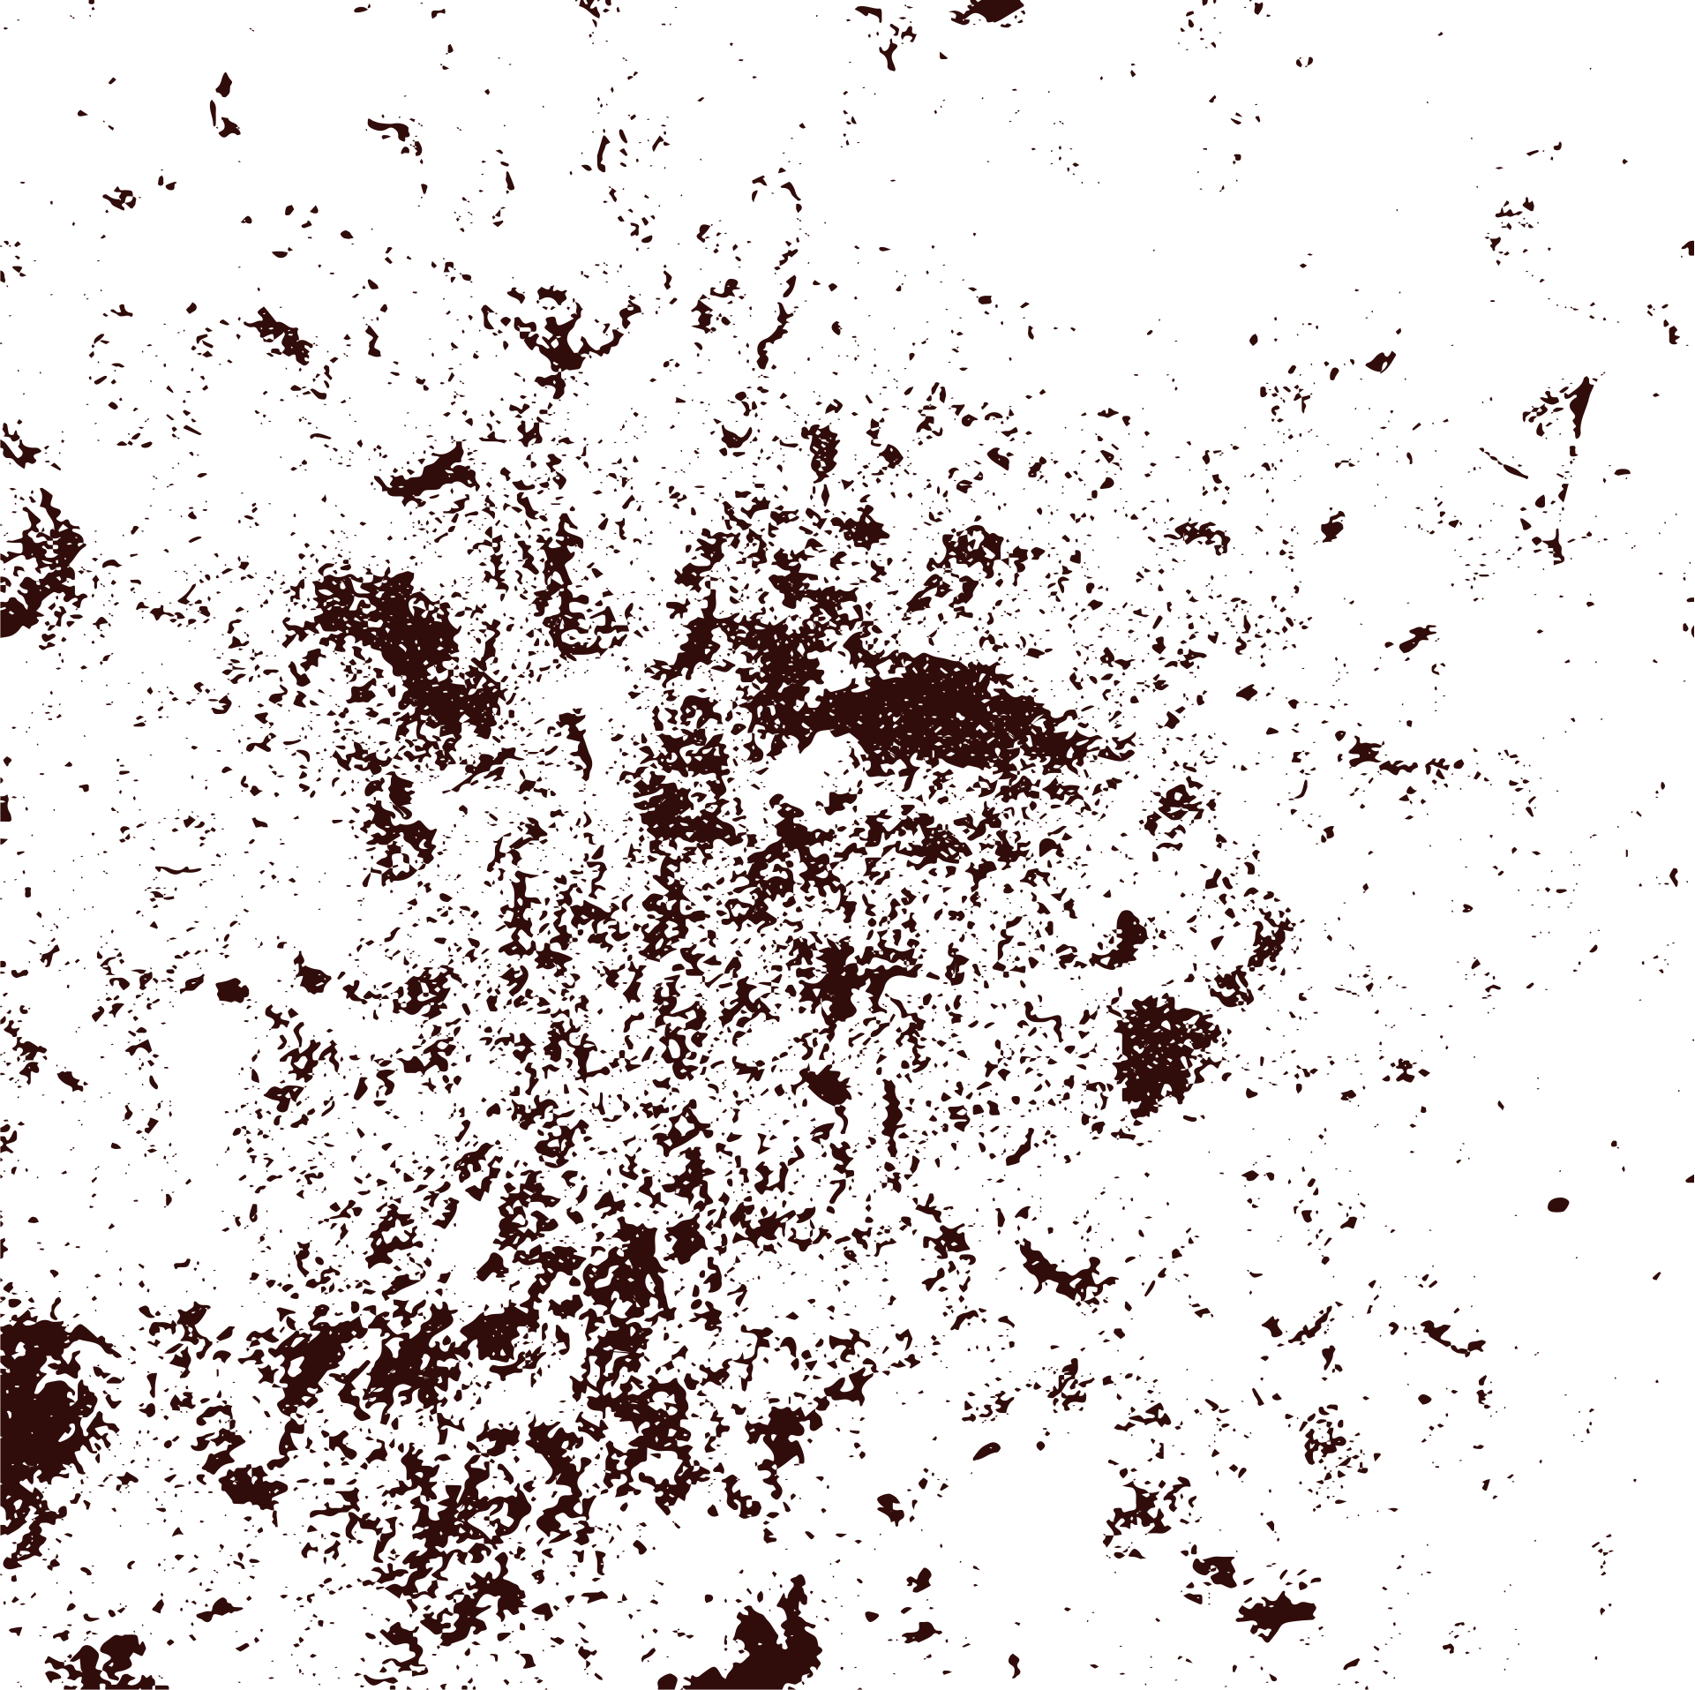



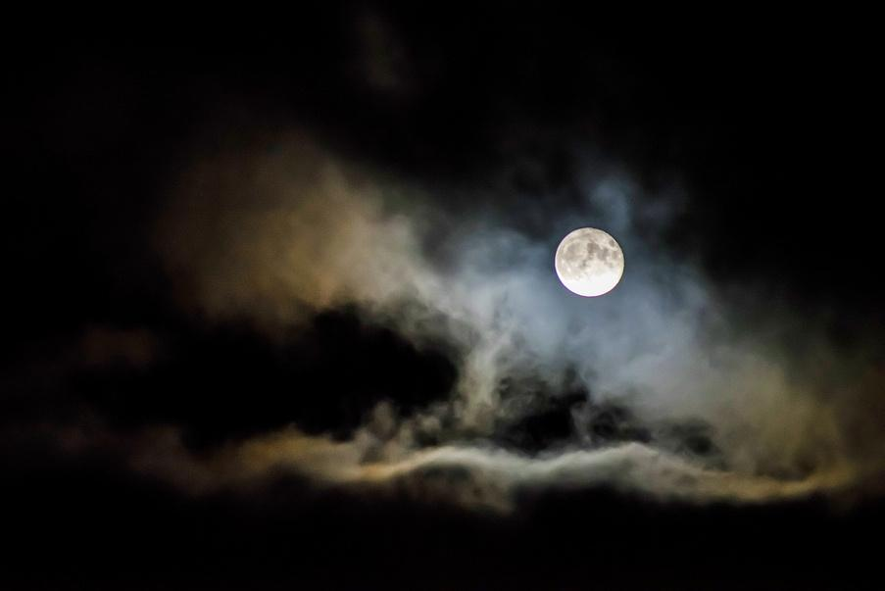
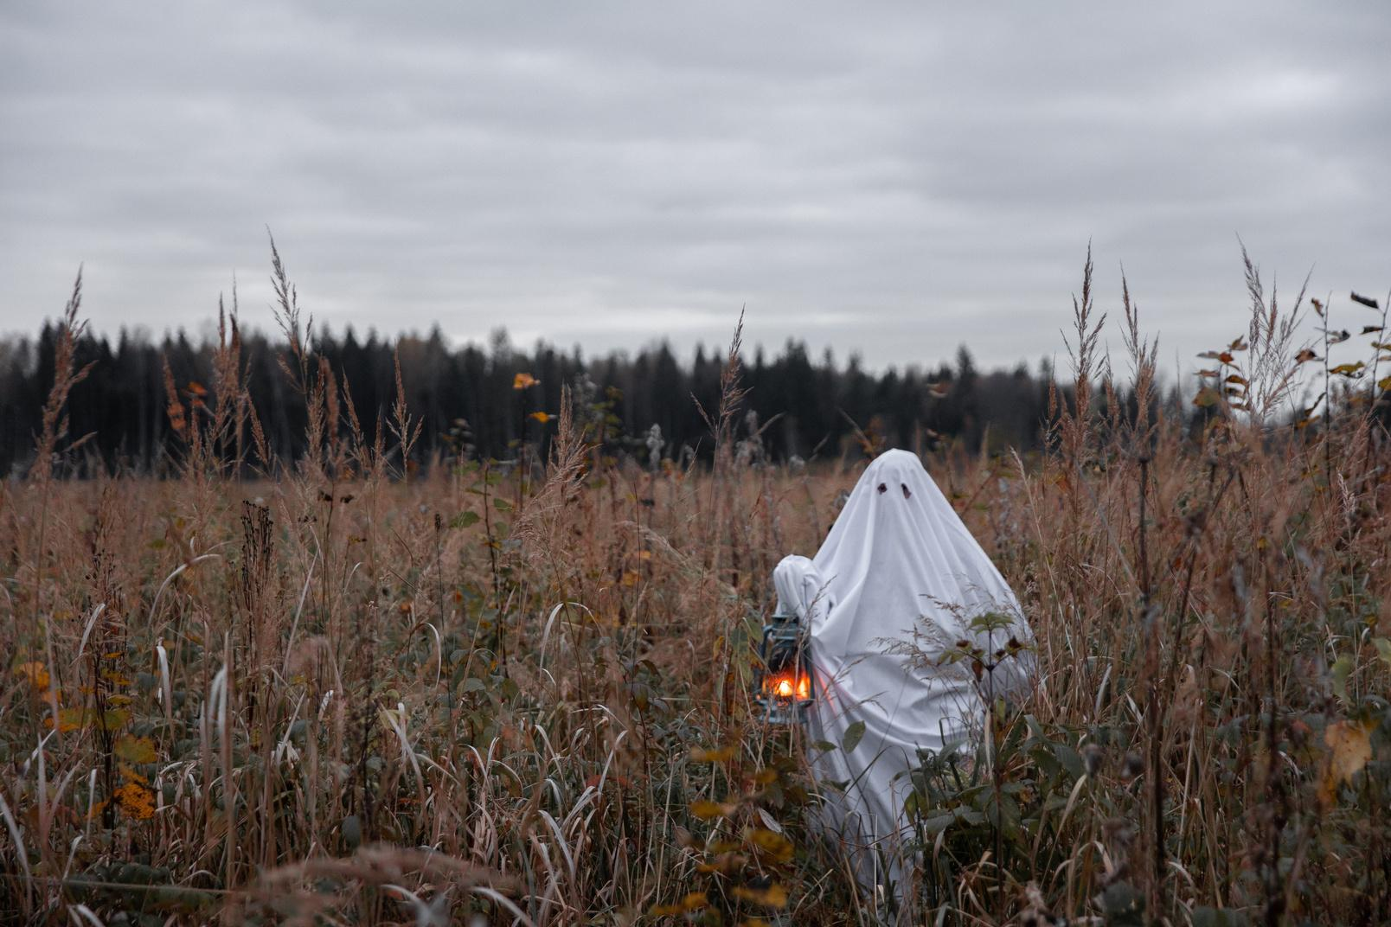
Case File
The Ghost of Room 13
An RMPS Investigation

Slide 2


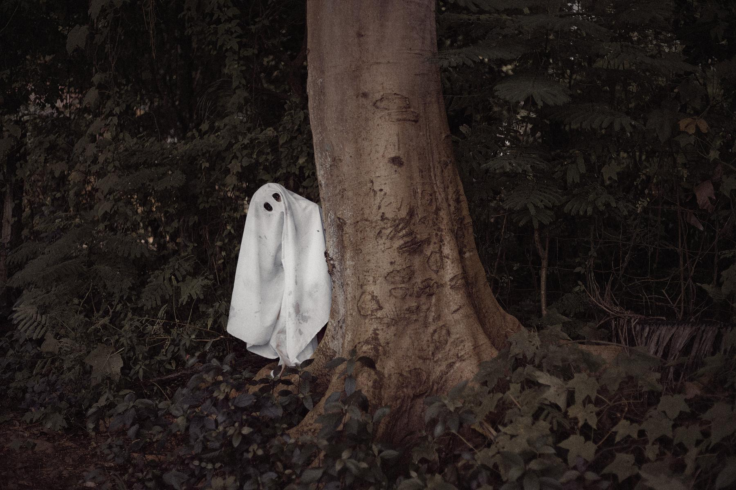
Case File
What happened?

Slide 3

The Evidence
Add your two clues
Clue 1
Clue 2
Clue 1
Clue 2

Slide 4
The Theories
Natural explanation
Supernatural explanation
explanation
explanation

Slide 5
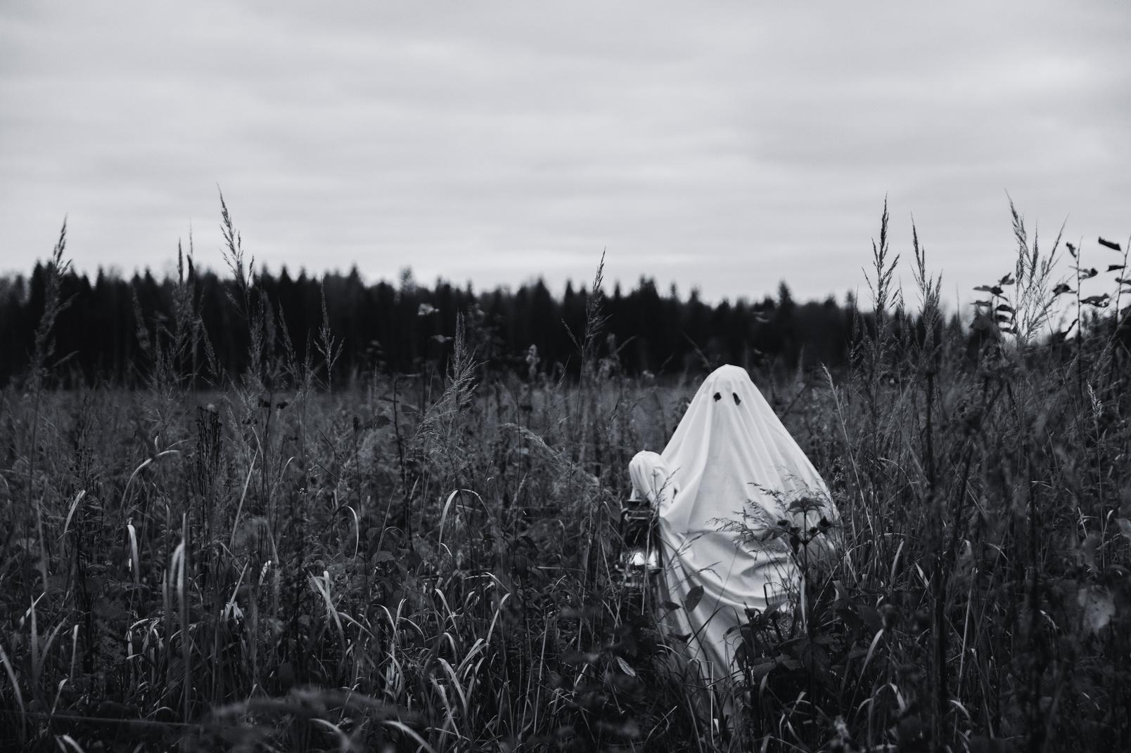
Samhain Connection
How might beliefs about the Otherworld influence people’s interpretation?
Answer

Slide 6

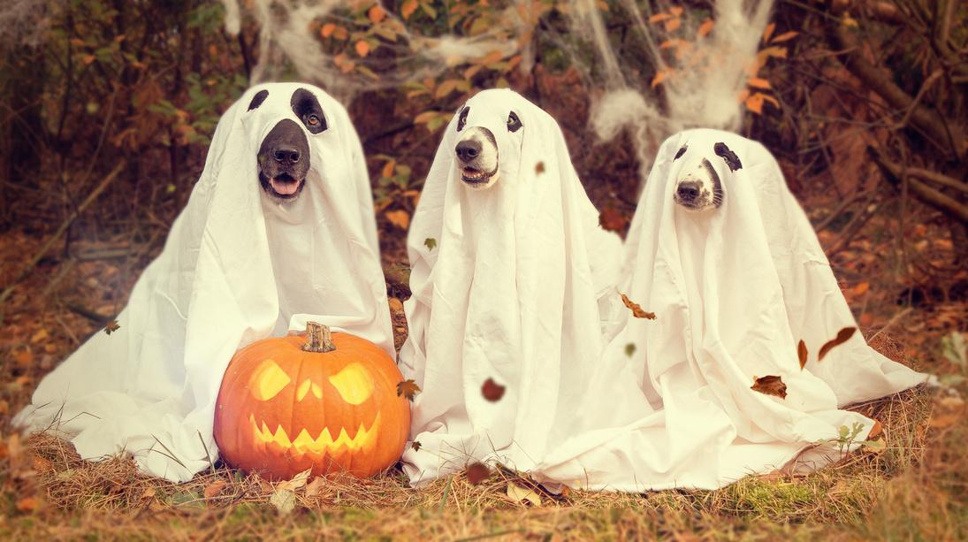

Our Verdict
What do we think happened? Why?
Answer

