Slide 1

Mentoring and RME/RMPS
Colin Whittet

Slide 2
Session Aims
Introduction
How mentoring and RME/RMPS are linked
Why mentoring is needed
Case studies
Next steps

Slide 3
Who am I?

Slide 4
Mentoring and RME
“the act or process of helping and giving advice to a younger or less experienced person over a period of time, especially in a job or at school. It involves a collaborative relationship where mentors act as role models and support mentees in their growth and professional development.”
Cambridge University Press
Religious and moral education is a process where children and young people engage in a search for meaning, value and purpose in life. This involves both the exploration of beliefs and values and the study of how such beliefs and values are expressed.
Building the Curriculum 1

Slide 5
Mentoring and RME
“the act or process of helping and giving advice to a younger or less experienced person over a period of time, especially in a job or at school. It involves a collaborative relationship where mentors act as role models and support mentees in their growth and professional development.”
Cambridge University Press
Religious and moral education is a process where children and young people engage in a search for meaning, value and purpose in life. This involves both the exploration of beliefs and values and the study of how such beliefs and values are expressed.
Building the Curriculum 1

Slide 6
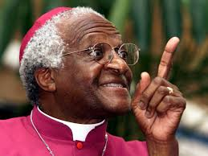
“There comes a point where we need to stop
just pulling people out of the river.
We need to go upstream and find out why
they’re falling in.”
Desmond Tutu

Slide 7
Why are people/children “falling in the river”?
66–74% of Scottish children experience at least one Adverse Childhood Experience (ACE)
(Source: Scottish Government)
10–14% experience multiple ACEs (3+)
(Source: Growing Up in Scotland; Scottish Government analysis)
31% of young people report being bullied
(Source: Growing Up in Scotland study)
40–43% of pupils are recorded as having ASN
(Source: Scottish Government)
15–20% grow up with parental alcohol or drug misuse
(Source: Scottish Health Survey – ACE module)

Slide 8
Why are people/children “falling in the river”?
Positive feelings about school (including feeling treated fairly and supported) decline in secondary school (S1–S4)
Pupils in more deprived areas are less likely to feel:
happy at school
treated fairly by teachers
positive about their future
(Source: Scottish Government – Health and Wellbeing Census 2021/22)

Slide 9
Only 43% of young people feel safe at school
(Source: Young Scot Truth About Youth survey 2024–25)

Slide 10
As I play and learn, I am developing my understanding of what is fair and unfair and the importance of caring for, sharing and cooperating with others.
RME 0-02a
I am developing awareness that some people have beliefs and values which are independent of religion
RME 1-09a
I can share my developing views about values such as fairness and equality and love, caring, sharing and human rights
RME 2-05b
I can explain why different people think that values such as honesty, respect and compassion are important, and I show respect for others
RME 2-09c
I can demonstrate my developing understanding of moral values through participating in events and projects which make a positive difference to others
RME 3-02b
I can apply my developing understanding of morality to consider a range of moral dilemmas in order to find ways which could promote a more just and compassionate society.
RME 4-02b

Slide 11
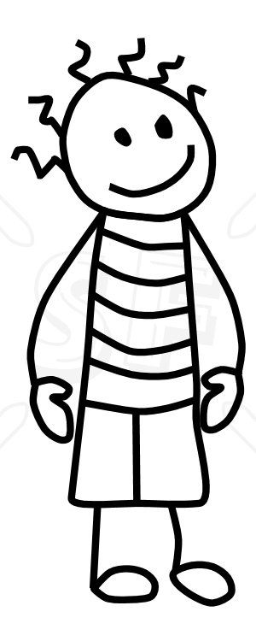
Case Study 1
Responds well to 1:1 time
Loves being outdoors / football
Can open up and be honest
Can now laugh at his own mistakes / mishaps – falls out with others less often
Sometimes forgets he’s got a tough man persona he thinks he must live up to
Confidence in school – Higher level of engagement. Has recently expressed disappointment at having to leave school early
Lacks academic ability – taking on responsibility of adding up points in games, enquiring mind, more open to reading

Slide 12
Case Study 2
Able to be honest
Now realises previous bullying was nothing to do with him
Had been panicking about bullies again at high school
Confidence in school – Can speak up for himself more, and others, as a result of confidence building / CBT strategies and greater understanding of a just society
Confidence in himself – Knows his strengths and that his identity doesn’t come from other’s opinions
Volunteered to present to the class what he had been doing

Slide 13
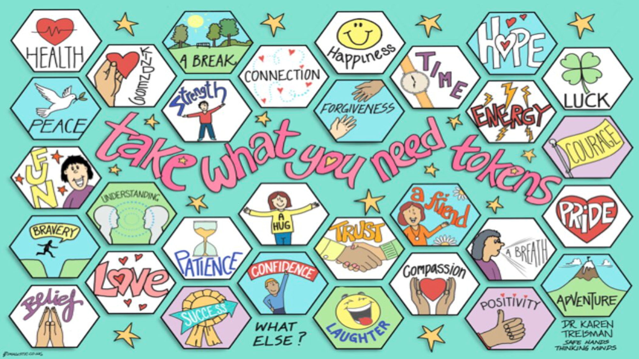

Slide 14


Slide 15
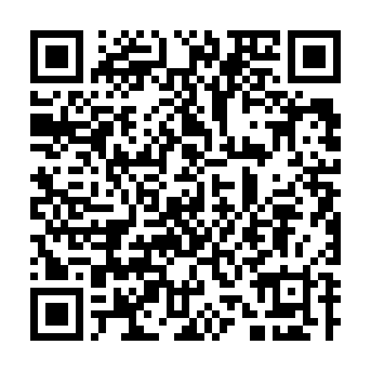
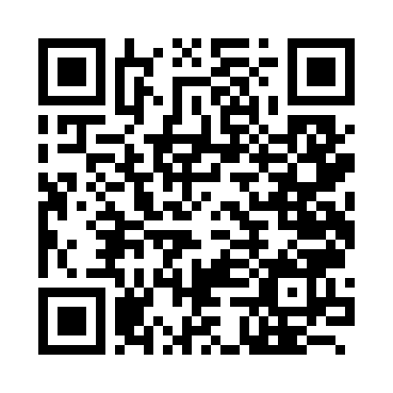
Colin Whittet
Starfish Coordinator – North Lanarkshire
colin.whittet@salvationarmy.org.uk
FAQ
Mentee Interview

