Slide 1




St Andrew’s Foundation for Catholic Teacher Education
Identifying Problems of Practice in
Religious Education
Ellen Boeren
Margery McMahon
Roisin Coll

Slide 2

What would a research agenda shaped by RE teachers look like?

Slide 3

Identifying Problems of Practice in Religious Education
Focus on problems of practice shaping contemporary RE teaching
Grounded in research evidence from UK universities
Informed by Boeren, McMahon & Coll’s (2024) thematic analysis of RE research
Aims to connect:
Research
Teacher voice
Advocacy for change

Slide 4
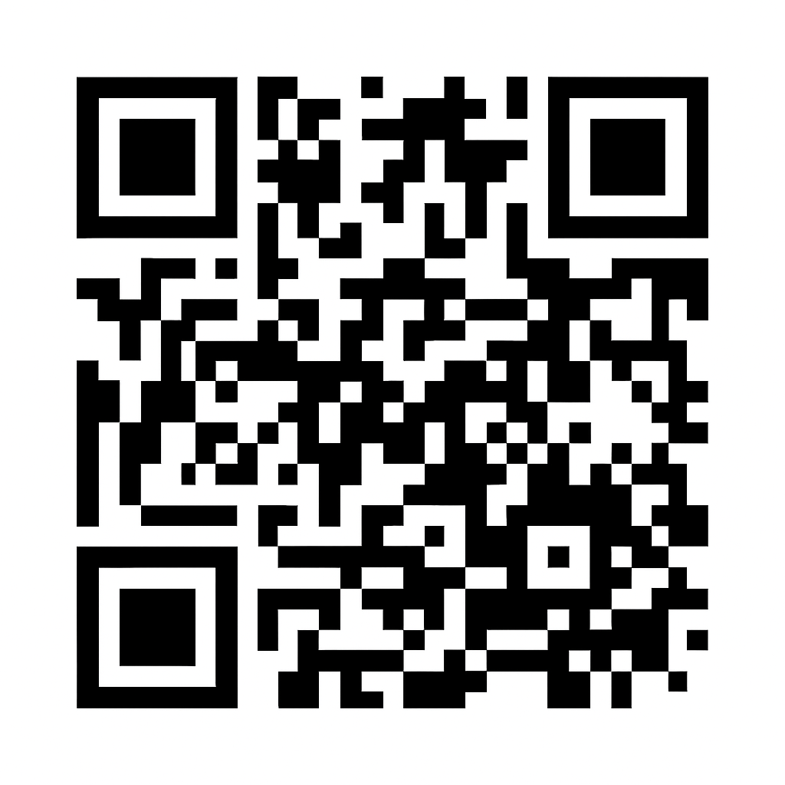
Boeren, McMahon & Coll (2024)
Examines REF 2021 submissions to Education (UoA23)
Identifies research outputs relating to religion and RE
Uses thematic analysis to map:
  What is being researched
  What is missing or under‑represented
Raises questions about the future research agenda for RE
Key insight
REF provides a snapshot of the “state of the art” in RE research

Slide 5
Emerging Themes in RE Research
The analysis highlights concentrations of research around:
Policy, systems and structures shaping RE
Religion, education, and social diversity
Curriculum knowledge and its framing
The wider role of religion in education beyond RE lessons
Key takeaway:
Strong academic interest, but uneven coverage of classroom realities

Slide 6
Where Are the Problems of Practice?
Limited visibility of teacher‑led and classroom‑based research
Disconnect between:
    Policy discourse
    Lived classroom challenges
RE often framed about teachers rather than with teachers
Uneven alignment between research priorities and school realities
Key question
Whose voices shape the RE research agenda?

Slide 7
Connecting Themes to Practice
Making the Research Meaningful
In small groups, consider:
Which themes resonate most with your RE context?
Which feel distant or missing?
How do these themes connect to:
  Your pupils’ experiences?
  Local challenges (time, status, diversity, accountability)?
Feedback
Identify 1 strong connection and 1 concern

Slide 8
Research‑Led Teaching in RE
Why This Matters for Practice
Research‑led teaching:
  Strengthens professional confidence
  Supports curriculum justification and coherence
The article highlights the need to:
  Better connect university research with schools
  Enable teachers to use and shape research
How do you currently engage with RE research?

Slide 9
Teacher Voice, Agency & Advocacy
Teacher voice is essential to:
  Identifying authentic problems of practice
  Challenging marginalisation of RE
Teacher‑informed research can act as:
  Advocacy for curriculum time
  Evidence for policy engagement
Challenge
What structures would enable stronger teacher agency in RE research?

Slide 10

Towards a Future Research Agenda
Setting Priorities Together
Priority problems of practice needing investigation
Gaps between research, policy and classrooms
Opportunities for:
  Practitioner research
  School–university collaboration
What would a research agenda shaped by RE teachers look like?

Slide 11


Slide 12


Aim of the CfTE
To support teachers, including those in Gaelic Medium Education, to actively lead and engage with research and evidence to help inform and develop their practice.
Work in collaboration with teachers to identify areas of priority.
Support practice-focused research in relation to priorities, for example through practitioner enquiry.
Sharing of research, evidence and experiences with teachers.
Gather national and international evidence, ensuring wide accessibility.
Establish partnerships with key stakeholders to enable development of relevant research-practice collaborations.
Notes:
Teachers first and foremost
Supporting teachers to engage with research in the broadest sense
Engaging with research in their practice
Co-creating research/enquiry
Communities of practice
Connection to our hubs, both core and thematic
Connection with expertise across the wider sector: in fellow HEIs as well as external partners

Slide 13

cfte@glasgow.ac.uk
https://www.gla.ac.uk/research/az/teaching-excellence/
https://www.gla.ac.uk/research/az/teaching-excellence/gaelichome/

Slide 14


