Slide 1
MENTORING RMPS STUDENT TEACHERS
ORLAITH PAYNE, UNIVERSITY OF STRATHCLYDE

Slide 2

THINK
Think of your own student experience
Where were your placements?
How did it go?

Slide 3
PAIR
With your partner, quickly discuss your experience as a student teacher

Slide 4
SHARE
Let's discuss your answers:
  Good experiences - why?
  Poor experiences - why?

Slide 5
OBSERVING LESSONS
WHY IS IT IMPORTANT?
Fluent - your teaching looks easy but remember to provide the student with a quick breakdown of the decisions taken, the successes and the weaknesses of the lesson - this shows that we too are reflective practitioners!

Slide 6
OBSERVING LESSONS
WHY IS IT IMPORTANT?
Remember you are not there to offer solutions to all the questions or difficulties the student has but rather to pose questions to help the student reflect on the issues and potentially find solutions themselves!

Slide 7
OBSERVING LESSONS
THE LESSON GOES ASKEW!
Remember one lesson is not going to detrail the knowledge of the students but it may be the making of the student teacher who needs a hands-on experience of the realities of teaching!

Slide 8
SUPPORT
WHAT IS IT?
  Developing an identity first as
  a teacher
  Developing an identity as a member of the school community
  Emotional/Pastoral Support

Slide 9
CHALLENGE
WHAT IS IT?
  Aimed at helping the student develop their teaching competence
  Needs to be appropriate to the student’s own development and to the stage the student is at in the course

Slide 10
BALANCING SUPPORT AND CHALLENGE
Successful placements depends on a thoughtful combination of both support and challenge.
Support provides the confidence, belonging, and wellbeing needed to thrive, while challenge encourages reflection, growth, and increasing competence in the classroom.

Slide 11
THINGS TO REMEMBER:
1ST IDEA
Work together to discuss the ‘why’ behind the lessons – not just the ‘what’ of the lesson
Involve the student in all aspects of teaching- from staff room antics to planning
Treat RMPS student as a genuine member of the team, not just an “extra set of hands.”

Slide 12
THINGS TO REMEMBER:
Listen to the student - find their strengths and work with them on their weaknesses
2ND IDEA
Compliment Sandwich - we do it for parents’ night so use this for students!
Ask reflective questions rather than simply giving directives or micromanaging

Slide 13
THINGS TO REMEMBER:
3RD IDEA
Start by giving students high levels of support, then slowly remove that as their confidence, skill and understanding grow.
Sense of self as a teacher is strengthened and the pupils see the student teacher as a teacher
Foster Gradual Autonomy - it is how we all learn!

Slide 14
ONE FINAL THOUGHT:
You do not need to follow the guidelines of the university handbooks to the letter - school and real life does not work like that so there is no expectation that your student will have to follow each page of the handbook word for word.
ANY QUESTIONS?

Slide 15
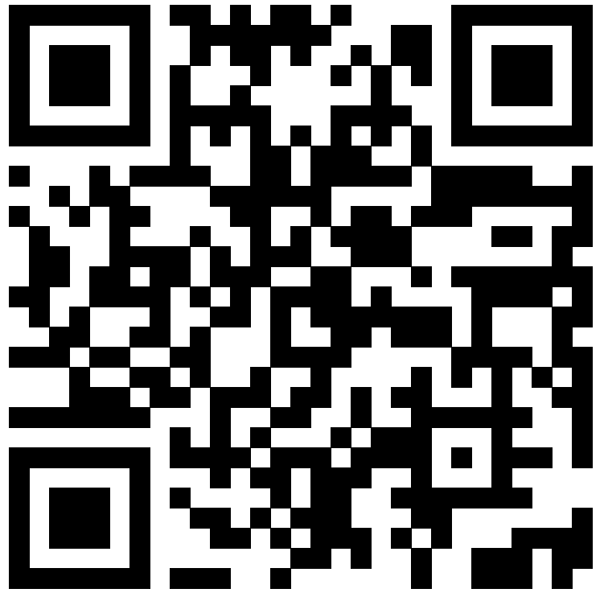
Could I ask one favour please??

Slide 16

CONTACT ME:
orlaith.payne@strath.ac.uk

Slide 17
REFERENCES USED:
Caires S., Almeida, L. and Vieira, D. (2012) ‘Becoming a teacher: student teachers’ experiences and perceptions about teaching practice’, European Journal of Teacher Education, vol. 35, no. 2, pp. 163–78.
Calderhead, J. and Shorrock, S. (1997) Understanding teacher education, London, Falmer Press.
Timoštšuk, I. and Ugaste, A. (2012) ‘The role of emotions in student teachers’ professional identity’, European Journal of Teacher Education, vol. 35, no. 4, pp. 421–33.

